Slide 1

Homework Review Session Garrett Merrion 12/11/2020
Have a notebook/paper and pencil!
Work along with me as I go through the problems
We will look at detailed solutions to most of the problems. I have slightly reordered them to follow concepts from start to finish.
If there is extra time after homework problems, I will answer general questions, and possibly take another look at the concept of normalization.
If I am going too fast, please let me know! I will be looking for feedback on the pace. $φ$

Slide 2

Review of exponent rules – write this down unless you know it well
$$e^{−x}=\frac{1}{e^{x}}$$
$$e^{x}e^{−x}=\frac{e^{x}}{e^{x}}=e^{x−x}=e^{0}=1$$
$$e^{ai}e^{−bi}=e^{i(a−b)}$$

Slide 3

$\left|\left.A\right\rangle \right.=a\left(\begin{matrix}5 \\ 3i\end{matrix}\right)$ $\left|\left.B\right\rangle \right.=b\left(\begin{matrix}−7 \\ 4e^{−i\frac{π}{3}}\end{matrix}\right)$ $\left\langle \left.C\right|\right.=c\left(1 e^{iπ/6}\right)$
1,5
$$\left\langle A | A\right\rangle =1$$
$$\left\langle \left.A\right|\right.=a^{∗}\left(5 −3i\right)$$
$$\left\langle A | A\right\rangle =a^{∗}\left(5 −3i\right)a\left(\begin{matrix}5 \\ 3i\end{matrix}\right)=a^{∗}a\left(25−9i^{2}\right)=34a^{∗}a$$
$$\left\langle A | A\right\rangle =34a^{2}=1 ; a^{2}=\frac{1}{34} ; a=\frac{1}{\sqrt{34}}$$
$$\left|\left.A\right\rangle \right.=\frac{1}{\sqrt{34}}\left(\begin{matrix}5 \\ 3i\end{matrix}\right)$$

Slide 4

$$\left|\left.B\right\rangle \right.=b\left(\begin{matrix}−7 \\ 4e^{−i\frac{π}{3}}\end{matrix}\right)$$
$$\left\langle \left.B\right|\right.=b^{∗}\left(−7 4e^{iπ/3}\right)$$
$$\left\langle B | B\right\rangle =1=b^{∗}\left(−7 4e^{iπ/3}\right)b\left(\begin{matrix}−7 \\ 4e^{−i\frac{π}{3}}\end{matrix}\right)$$
$$\left\langle B | B\right\rangle =b^{2}\left(49+16e^{iπ/3\left(1−1\right)}\right)$$
$$=b^{2}\left(49+16e^{0}\right)=65b^{2}=1$$
$$b=\frac{1}{\sqrt{65}}$$

Slide 5

$$\left\langle \left.C\right|\right.=c\left(1 e^{iπ/6}\right)$$
$$\left|\left.C\right\rangle \right.=c^{∗}\left(\begin{matrix}1 \\ e^{−i\frac{π}{6}}\end{matrix}\right)$$
$$\left\langle C | C\right\rangle =1=c\left(1 e^{iπ/6}\right)c^{∗}\left(\begin{matrix}1 \\ e^{−i\frac{π}{6}}\end{matrix}\right)$$
$$=c^{2}\left(1+e^{iπ/6\left(1−1\right)}\right)=c^{2}\left(1+e^{0}\right)$$
$$\left\langle C | C\right\rangle =2c^{2}=1$$
$$c=\frac{1}{\sqrt{2}}$$

Slide 6
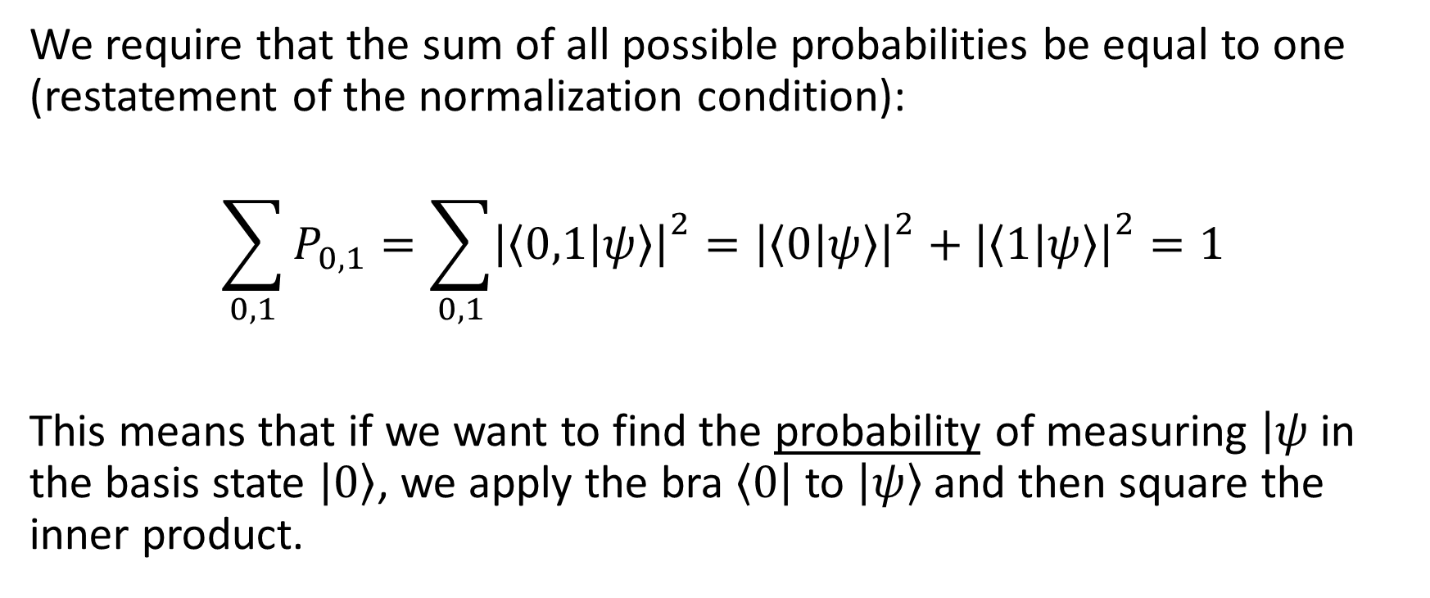
Finding the probability of measuring a particular state
We require that the sum of all possible probabilities be equal to one (restatement of the normalization condition):
$$\sum_{0,1}{P_{0,1}}=\sum_{0,1}{{\left|\left.\left\langle 0,1 | ψ\right\rangle \right|\right.}^{2}}={\left|\left.\left\langle 0 | ψ\right\rangle \right|\right.}^{2}+{\left|\left.\left\langle 1 | ψ\right\rangle \right|\right.}^{2}=1$$
This means that if we want to find the probability of measuring $\left|ψ\right.$ in the basis state $\left|\left.0\right\rangle \right.$, we apply the bra $\left\langle \left.0\right|\right.$ to $\left|\left.ψ\right\rangle \right.$ and then square the inner product.

Slide 7

14-21
$\left|\left.+\right\rangle \right.=\frac{1}{\sqrt{2}}\left(\left|\left.0\right\rangle \right.+\left|\left.1\right\rangle \right.\right) ;$ $\left|\left.−\right\rangle \right.=\frac{1}{\sqrt{2}}\left(\left|\left.0\right\rangle \right.−\left|\left.1\right\rangle \right.\right) ;$ $\left|\left.φ\right\rangle \right.=\frac{1}{\sqrt{13}}\left(2\left|\left.0\right\rangle \right.+3e^{iπ/4}\left|\left.1\right\rangle \right.\right)$
14. Vector form:
$${\left|\left.\left\langle 0 | +\right\rangle \right|\right.}^{2}=\frac{1}{\sqrt{2}}\frac{1}{\sqrt{2}}\left[\left(\begin{matrix}1 & 0\end{matrix}\right)\left(\begin{matrix}1 \\ 0\end{matrix}\right)+\left(\begin{matrix}1 & 0\end{matrix}\right)\left(\begin{matrix}0 \\ 1\end{matrix}\right)\right]=\frac{1}{2}$$
Dirac (bra-ket) notation:
$${\left|\left.\left\langle 0 | +\right\rangle \right|\right.}^{2}=\frac{1}{\sqrt{2}}\frac{1}{\sqrt{2}}\left(\left\langle 0 | 0\right\rangle +\left\langle 0 | 1\right\rangle \right)=\frac{1}{2}$$

Slide 8

$\left|\left.+\right\rangle \right.=\frac{1}{\sqrt{2}}\left(\left|\left.0\right\rangle \right.+\left|\left.1\right\rangle \right.\right) ;$ $\left|\left.−\right\rangle \right.=\frac{1}{\sqrt{2}}\left(\left|\left.0\right\rangle \right.−\left|\left.1\right\rangle \right.\right) ;$ $\left|\left.φ\right\rangle \right.=\frac{1}{\sqrt{13}}\left(2\left|\left.0\right\rangle \right.+3e^{iπ/4}\left|\left.1\right\rangle \right.\right)$
16.
$$P_{0}={\left|\left.\left\langle 0 | φ\right\rangle \right|\right.}^{2}$$
$$=\frac{1}{\sqrt{13}}\frac{1}{\sqrt{13}}\left(2(2)\left\langle 0 | 0\right\rangle +3e^{\frac{iπ}{4}}(3e^{−\frac{iπ}{4}})\left\langle 0 | 1\right\rangle \right)$$
$${\left|\left.\left\langle 0 | φ\right\rangle \right|\right.}^{2}=\frac{1}{\sqrt{13}}\frac{1}{\sqrt{13}}\left(4\right)=\frac{4}{13}$$

Slide 9
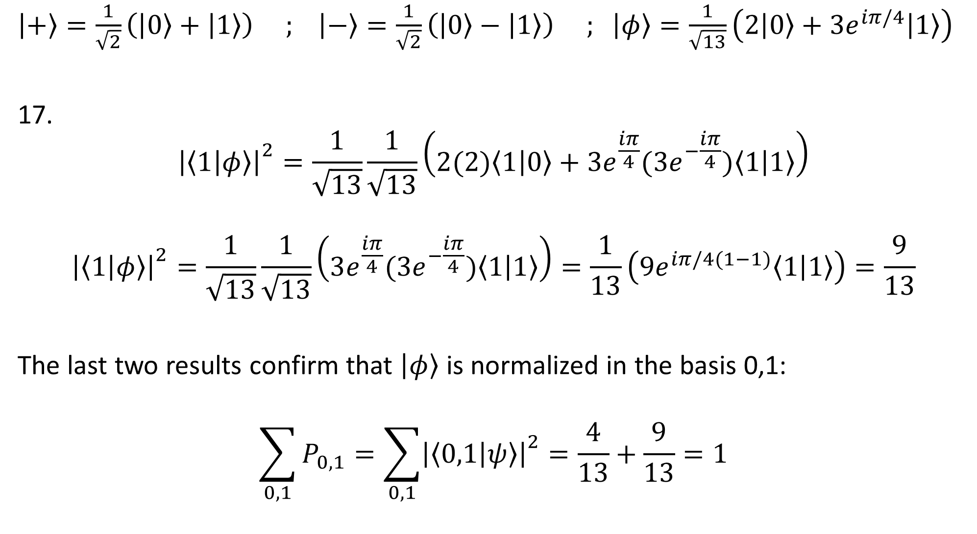
$\left|\left.+\right\rangle \right.=\frac{1}{\sqrt{2}}\left(\left|\left.0\right\rangle \right.+\left|\left.1\right\rangle \right.\right) ;$ $\left|\left.−\right\rangle \right.=\frac{1}{\sqrt{2}}\left(\left|\left.0\right\rangle \right.−\left|\left.1\right\rangle \right.\right) ;$ $\left|\left.φ\right\rangle \right.=\frac{1}{\sqrt{13}}\left(2\left|\left.0\right\rangle \right.+3e^{iπ/4}\left|\left.1\right\rangle \right.\right)$
17.
$${\left|\left.\left\langle 1 | φ\right\rangle \right|\right.}^{2}=\frac{1}{\sqrt{13}}\frac{1}{\sqrt{13}}\left(2(2)\left\langle 1 | 0\right\rangle +3e^{\frac{iπ}{4}}(3e^{−\frac{iπ}{4}})\left\langle 1 | 1\right\rangle \right)$$
$${\left|\left.\left\langle 1 | φ\right\rangle \right|\right.}^{2}=\frac{1}{\sqrt{13}}\frac{1}{\sqrt{13}}\left(3e^{\frac{iπ}{4}}(3e^{−\frac{iπ}{4}})\left\langle 1 | 1\right\rangle \right)=\frac{1}{13}\left(9e^{iπ/4(1−1)}\left\langle 1 | 1\right\rangle \right)=\frac{9}{13}$$
The last two results confirm that $\left|\left.φ\right\rangle \right.$ is normalized in the basis 0,1:
$$\sum_{0,1}{P_{0,1}}=\sum_{0,1}{{\left|\left.\left\langle 0,1 | ψ\right\rangle \right|\right.}^{2}}=\frac{4}{13}+\frac{9}{13}=1$$

Slide 10

$\left|\left.+\right\rangle \right.=\frac{1}{\sqrt{2}}\left(\left|\left.0\right\rangle \right.+\left|\left.1\right\rangle \right.\right) ;$ $\left|\left.−\right\rangle \right.=\frac{1}{\sqrt{2}}\left(\left|\left.0\right\rangle \right.−\left|\left.1\right\rangle \right.\right) ;$ $\left|\left.φ\right\rangle \right.=\frac{1}{\sqrt{13}}\left(2\left|\left.0\right\rangle \right.+3e^{iπ/4}\left|\left.1\right\rangle \right.\right)$
19.
$$\left\langle + | −\right\rangle =\frac{1}{2}\left(\left\langle 0 | 0\right\rangle +\left\langle 1 | 0\right\rangle −\left\langle 0 | 1\right\rangle −\left\langle 1 | 1\right\rangle \right)=0$$
20.
$$\left\langle φ | +\right\rangle =\frac{1}{\sqrt{13}}\frac{1}{\sqrt{2}}(2\left\langle 0 | 0\right\rangle +2\left\langle 0 | 1\right\rangle +3e^{−\frac{iπ}{4}}\left\langle 1 | 0\right\rangle +3e^{−iπ/4}\left\langle 1 | 1\right\rangle )$$
$$\left\langle φ | +\right\rangle =\frac{1}{\sqrt{26}} (2+3e^{−iπ/4})$$

Slide 11

$\left|\left.+\right\rangle \right.=\frac{1}{\sqrt{2}}\left(\left|\left.0\right\rangle \right.+\left|\left.1\right\rangle \right.\right) ;$ $\left|\left.−\right\rangle \right.=\frac{1}{\sqrt{2}}\left(\left|\left.0\right\rangle \right.−\left|\left.1\right\rangle \right.\right) ;$ $\left|\left.φ\right\rangle \right.=\frac{1}{\sqrt{13}}\left(2\left|\left.0\right\rangle \right.+3e^{iπ/4}\left|\left.1\right\rangle \right.\right)$
21.
$$\left\langle − | φ\right\rangle =\frac{1}{\sqrt{2}}\frac{1}{\sqrt{13}}(2\left\langle 0 | 0\right\rangle +3e^{\frac{iπ}{4}}\left\langle 0 | 1\right\rangle −2\left\langle 1 | 0\right\rangle −3e^{iπ/4}\left\langle 1 | 1\right\rangle )$$
$$\left\langle − | φ\right\rangle =\frac{1}{\sqrt{2}}\frac{1}{\sqrt{13}}(2\left\langle 0 | 0\right\rangle −3e^{iπ/4}\left\langle 1 | 1\right\rangle )$$
$$\left\langle − | φ\right\rangle =\frac{1}{\sqrt{26}} (2−3e^{iπ/4})$$

Slide 12
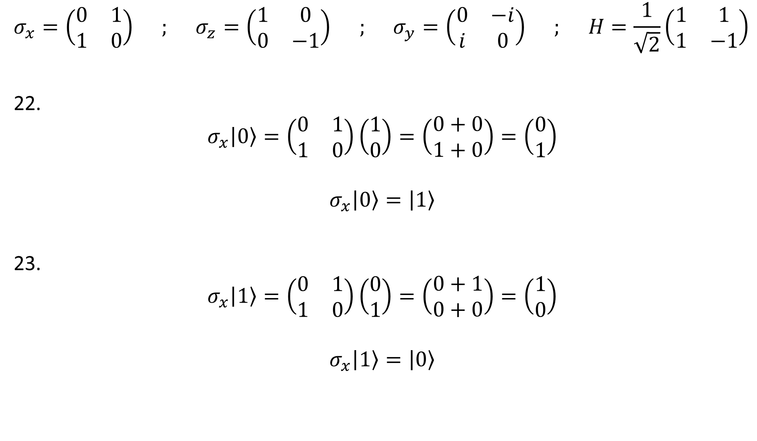
$$σ_{x}=\left(\begin{matrix}0 & 1 \\ 1 & 0\end{matrix}\right) ; σ_{z}=\left(\begin{matrix}1 & 0 \\ 0 & −1\end{matrix}\right) ; σ_{y}=\left(\begin{matrix}0 & −i \\ i & 0\end{matrix}\right) ; H=\frac{1}{\sqrt{2}}\left(\begin{matrix}1 & 1 \\ 1 & −1\end{matrix}\right)$$
22.
$$σ_{x}\left|\left.0\right\rangle \right.=\left(\begin{matrix}0 & 1 \\ 1 & 0\end{matrix}\right)\left(\begin{matrix}1 \\ 0\end{matrix}\right)=\left(\begin{matrix}0+0 \\ 1+0\end{matrix}\right)=\left(\begin{matrix}0 \\ 1\end{matrix}\right)$$
$$σ_{x}\left|\left.0\right\rangle \right.=\left|\left.1\right\rangle \right.$$
23.
$$σ_{x}\left|\left.1\right\rangle \right.=\left(\begin{matrix}0 & 1 \\ 1 & 0\end{matrix}\right)\left(\begin{matrix}0 \\ 1\end{matrix}\right)=\left(\begin{matrix}0+1 \\ 0+0\end{matrix}\right)=\left(\begin{matrix}1 \\ 0\end{matrix}\right)$$
$$σ_{x}\left|\left.1\right\rangle \right.=\left|\left.0\right\rangle \right.$$

Slide 13

$$σ_{x}=\left(\begin{matrix}0 & 1 \\ 1 & 0\end{matrix}\right) ; σ_{z}=\left(\begin{matrix}1 & 0 \\ 0 & −1\end{matrix}\right) ; σ_{y}=\left(\begin{matrix}0 & −i \\ i & 0\end{matrix}\right) ; H=\frac{1}{\sqrt{2}}\left(\begin{matrix}1 & 1 \\ 1 & −1\end{matrix}\right)$$
24.
$$σ_{y}\left|\left.0\right\rangle \right.=\left(\begin{matrix}0 & −i \\ i & 0\end{matrix}\right)\left(\begin{matrix}1 \\ 0\end{matrix}\right)=\left(\begin{matrix}0+0 \\ i+0\end{matrix}\right)=\left(\begin{matrix}0 \\ i\end{matrix}\right)$$
$$σ_{y}\left|\left.0\right\rangle \right.=i\left|\left.1\right\rangle \right.$$
25.
$$σ_{y}\left|\left.1\right\rangle \right.=\left(\begin{matrix}0 & −i \\ i & 0\end{matrix}\right)\left(\begin{matrix}0 \\ 1\end{matrix}\right)=\left(\begin{matrix}0−i \\ 0+0\end{matrix}\right)=\left(\begin{matrix}−i \\ 0\end{matrix}\right)$$
$$σ_{y}\left|\left.1\right\rangle \right.=−i\left|\left.0\right\rangle \right.$$

Slide 14

$$σ_{x}=\left(\begin{matrix}0 & 1 \\ 1 & 0\end{matrix}\right) ; σ_{z}=\left(\begin{matrix}1 & 0 \\ 0 & −1\end{matrix}\right) ; σ_{y}=\left(\begin{matrix}0 & −i \\ i & 0\end{matrix}\right) ; H=\frac{1}{\sqrt{2}}\left(\begin{matrix}1 & 1 \\ 1 & −1\end{matrix}\right)$$
26.
$$σ_{z}\left|\left.0\right\rangle \right.=\left(\begin{matrix}1 & 0 \\ 0 & −1\end{matrix}\right)\left(\begin{matrix}1 \\ 0\end{matrix}\right)=\left(\begin{matrix}1+0 \\ 0+0\end{matrix}\right)=\left|\left.0\right\rangle \right.$$
27.
$$σ_{z}\left|\left.1\right\rangle =\right.−\left|\left.1\right\rangle \right.$$

Slide 15

$$σ_{x}=\left(\begin{matrix}0 & 1 \\ 1 & 0\end{matrix}\right) ; σ_{z}=\left(\begin{matrix}1 & 0 \\ 0 & −1\end{matrix}\right) ; σ_{y}=\left(\begin{matrix}0 & −i \\ i & 0\end{matrix}\right) ; H=\frac{1}{\sqrt{2}}\left(\begin{matrix}1 & 1 \\ 1 & −1\end{matrix}\right)$$
28.
$$H\left|\left.0\right\rangle \right.=\frac{1}{\sqrt{2}}\left(\begin{matrix}1 & 1 \\ 1 & −1\end{matrix}\right)\left(\begin{matrix}1 \\ 0\end{matrix}\right)=\frac{1}{\sqrt{2}}\left(\begin{matrix}1+0 \\ 1−0\end{matrix}\right)$$
$$=\frac{1}{\sqrt{2}}\left(\begin{matrix}1 \\ 1\end{matrix}\right)=\frac{1}{\sqrt{2}}\left(\left|\left.0\right\rangle \right.+\left|\left.1\right\rangle \right.\right)=\left|\left.+\right\rangle \right.$$
29.
$$H\left|\left.1\right\rangle \right.=\frac{1}{\sqrt{2}}\left(\begin{matrix}1 & 1 \\ 1 & −1\end{matrix}\right)\left(\begin{matrix}0 \\ 1\end{matrix}\right)=\frac{1}{\sqrt{2}}\left(\begin{matrix}0+1 \\ 0−1\end{matrix}\right)$$
$$=\frac{1}{\sqrt{2}}\left(\begin{matrix}1 \\ −1\end{matrix}\right)=\frac{1}{\sqrt{2}}\left(\left|\left.0\right\rangle \right.−\left|\left.1\right\rangle \right.\right)=\left|\left.−\right\rangle \right.$$

Slide 16
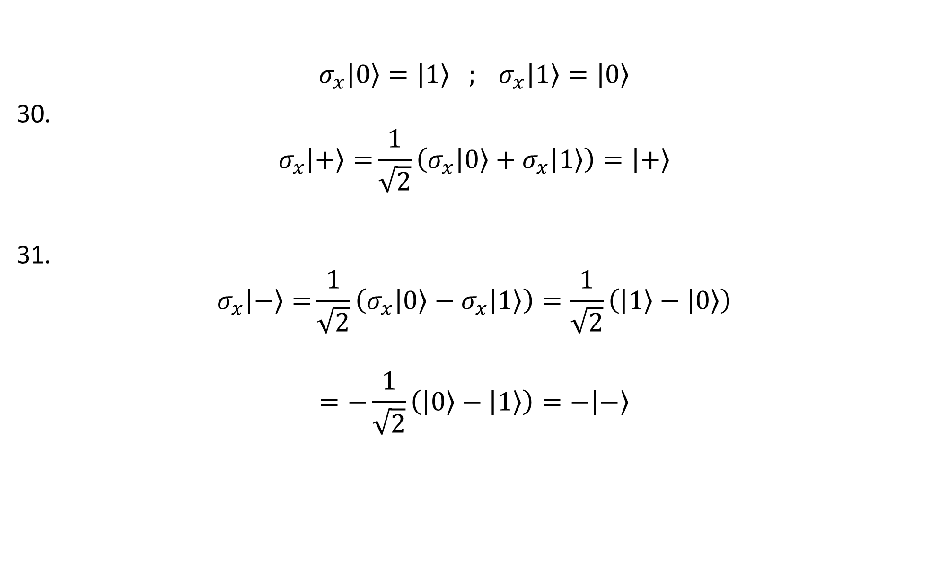
$$σ_{x}\left|\left.0\right\rangle \right.=\left|\left.1\right\rangle \right. ; σ_{x}\left|\left.1\right\rangle \right.=\left|\left.0\right\rangle \right.$$
30.
$$σ_{x}\left|\left.+\right\rangle =\right.\frac{1}{\sqrt{2}}\left(σ_{x}\left|\left.0\right\rangle \right.+σ_{x}\left|\left.1\right\rangle \right.\right)=\left|\left.+\right\rangle \right.$$
31.
$$σ_{x}\left|\left.−\right\rangle =\right.\frac{1}{\sqrt{2}}\left(σ_{x}\left|\left.0\right\rangle \right.−σ_{x}\left|\left.1\right\rangle \right.\right)=\frac{1}{\sqrt{2}}\left(\left|\left.1\right\rangle \right.−\left|\left.0\right\rangle \right.\right)$$
$$=−\frac{1}{\sqrt{2}}\left(\left|\left.0\right\rangle \right.−\left|\left.1\right\rangle \right.\right)=−\left|\left.−\right\rangle \right.$$

Slide 17
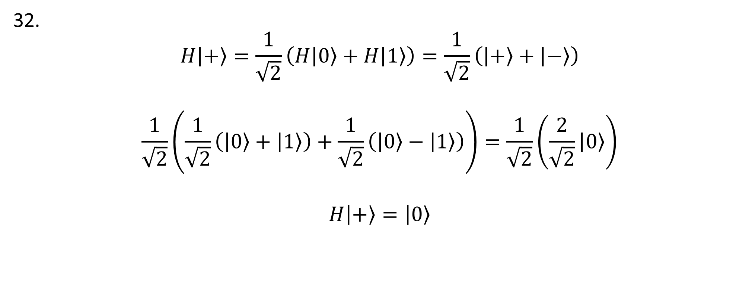

$$H\left|\left.0\right\rangle \right.=\left|\left.+\right\rangle \right. ; H\left|\left.1\right\rangle \right.=\left|\left.−\right\rangle \right.$$
32.
$$H\left|\left.+\right\rangle \right.=\frac{1}{\sqrt{2}}\left(H\left|\left.0\right\rangle \right.+H\left|\left.1\right\rangle \right.\right)=\frac{1}{\sqrt{2}}\left(\left|\left.+\right\rangle \right.+\left|\left.−\right\rangle \right.\right)$$
$$\frac{1}{\sqrt{2}}\left(\frac{1}{\sqrt{2}}\left(\left|\left.0\right\rangle \right.+\left|\left.1\right\rangle \right.\right)+\frac{1}{\sqrt{2}}\left(\left|\left.0\right\rangle \right.−\left|\left.1\right\rangle \right.\right)\right)=\frac{1}{\sqrt{2}}\left(\frac{2}{\sqrt{2}}\left|\left.0\right\rangle \right.\right)$$
$$H\left|\left.+\right\rangle \right.=\left|\left.0\right\rangle \right.$$

Slide 18


$$σ_{z}\left|\left.0\right\rangle \right.=\left|\left.0\right\rangle \right. ; σ_{z}\left|\left.1\right\rangle =\right.−\left|\left.1\right\rangle \right.$$
33.
$$σ_{z}\left|\left.+\right\rangle =\right.\frac{1}{\sqrt{2}}\left(σ_{z}\left|\left.0\right\rangle \right.+σ_{z}\left|\left.1\right\rangle \right.\right)=\frac{1}{\sqrt{2}}\left(\left|\left.0\right\rangle \right.−\left|\left.1\right\rangle \right.\right)=\left|\left.−\right\rangle \right.$$
$$σ_{z}\left|\left.+\right\rangle =\right. \left|\left.−\right\rangle \right.$$

Slide 19
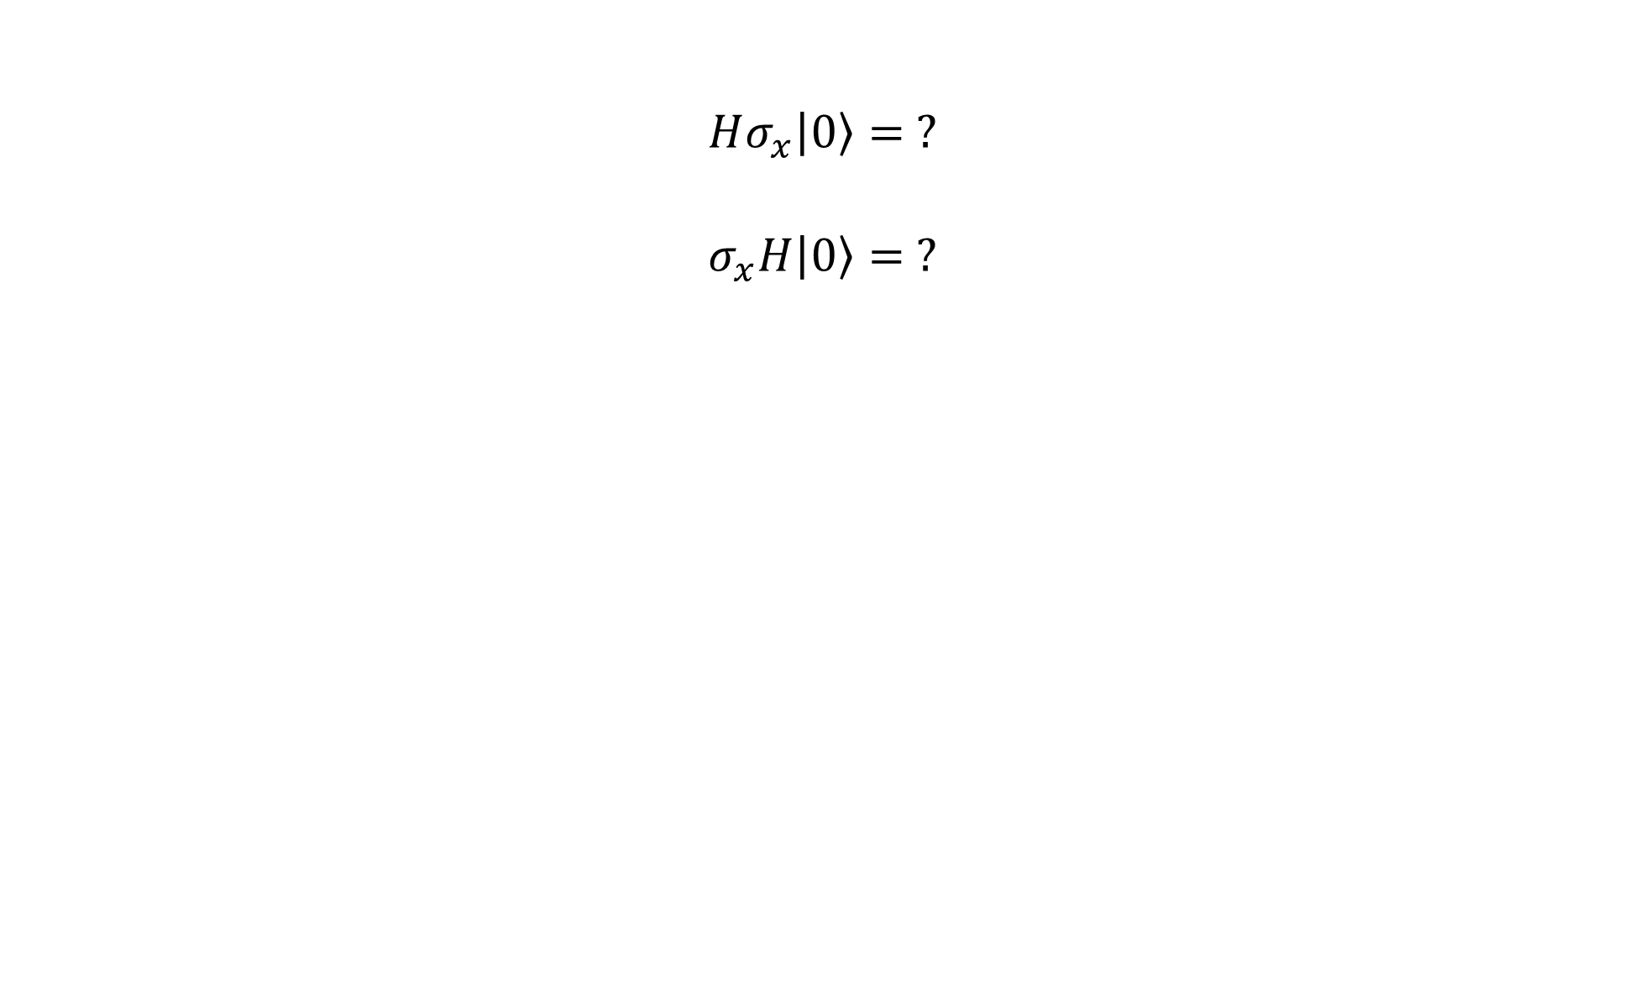
$$Hσ_{x}\left|\left.0\right\rangle \right.= ?$$
$$σ_{x}H\left|\left.0\right\rangle \right.= ?$$

